Slide 1
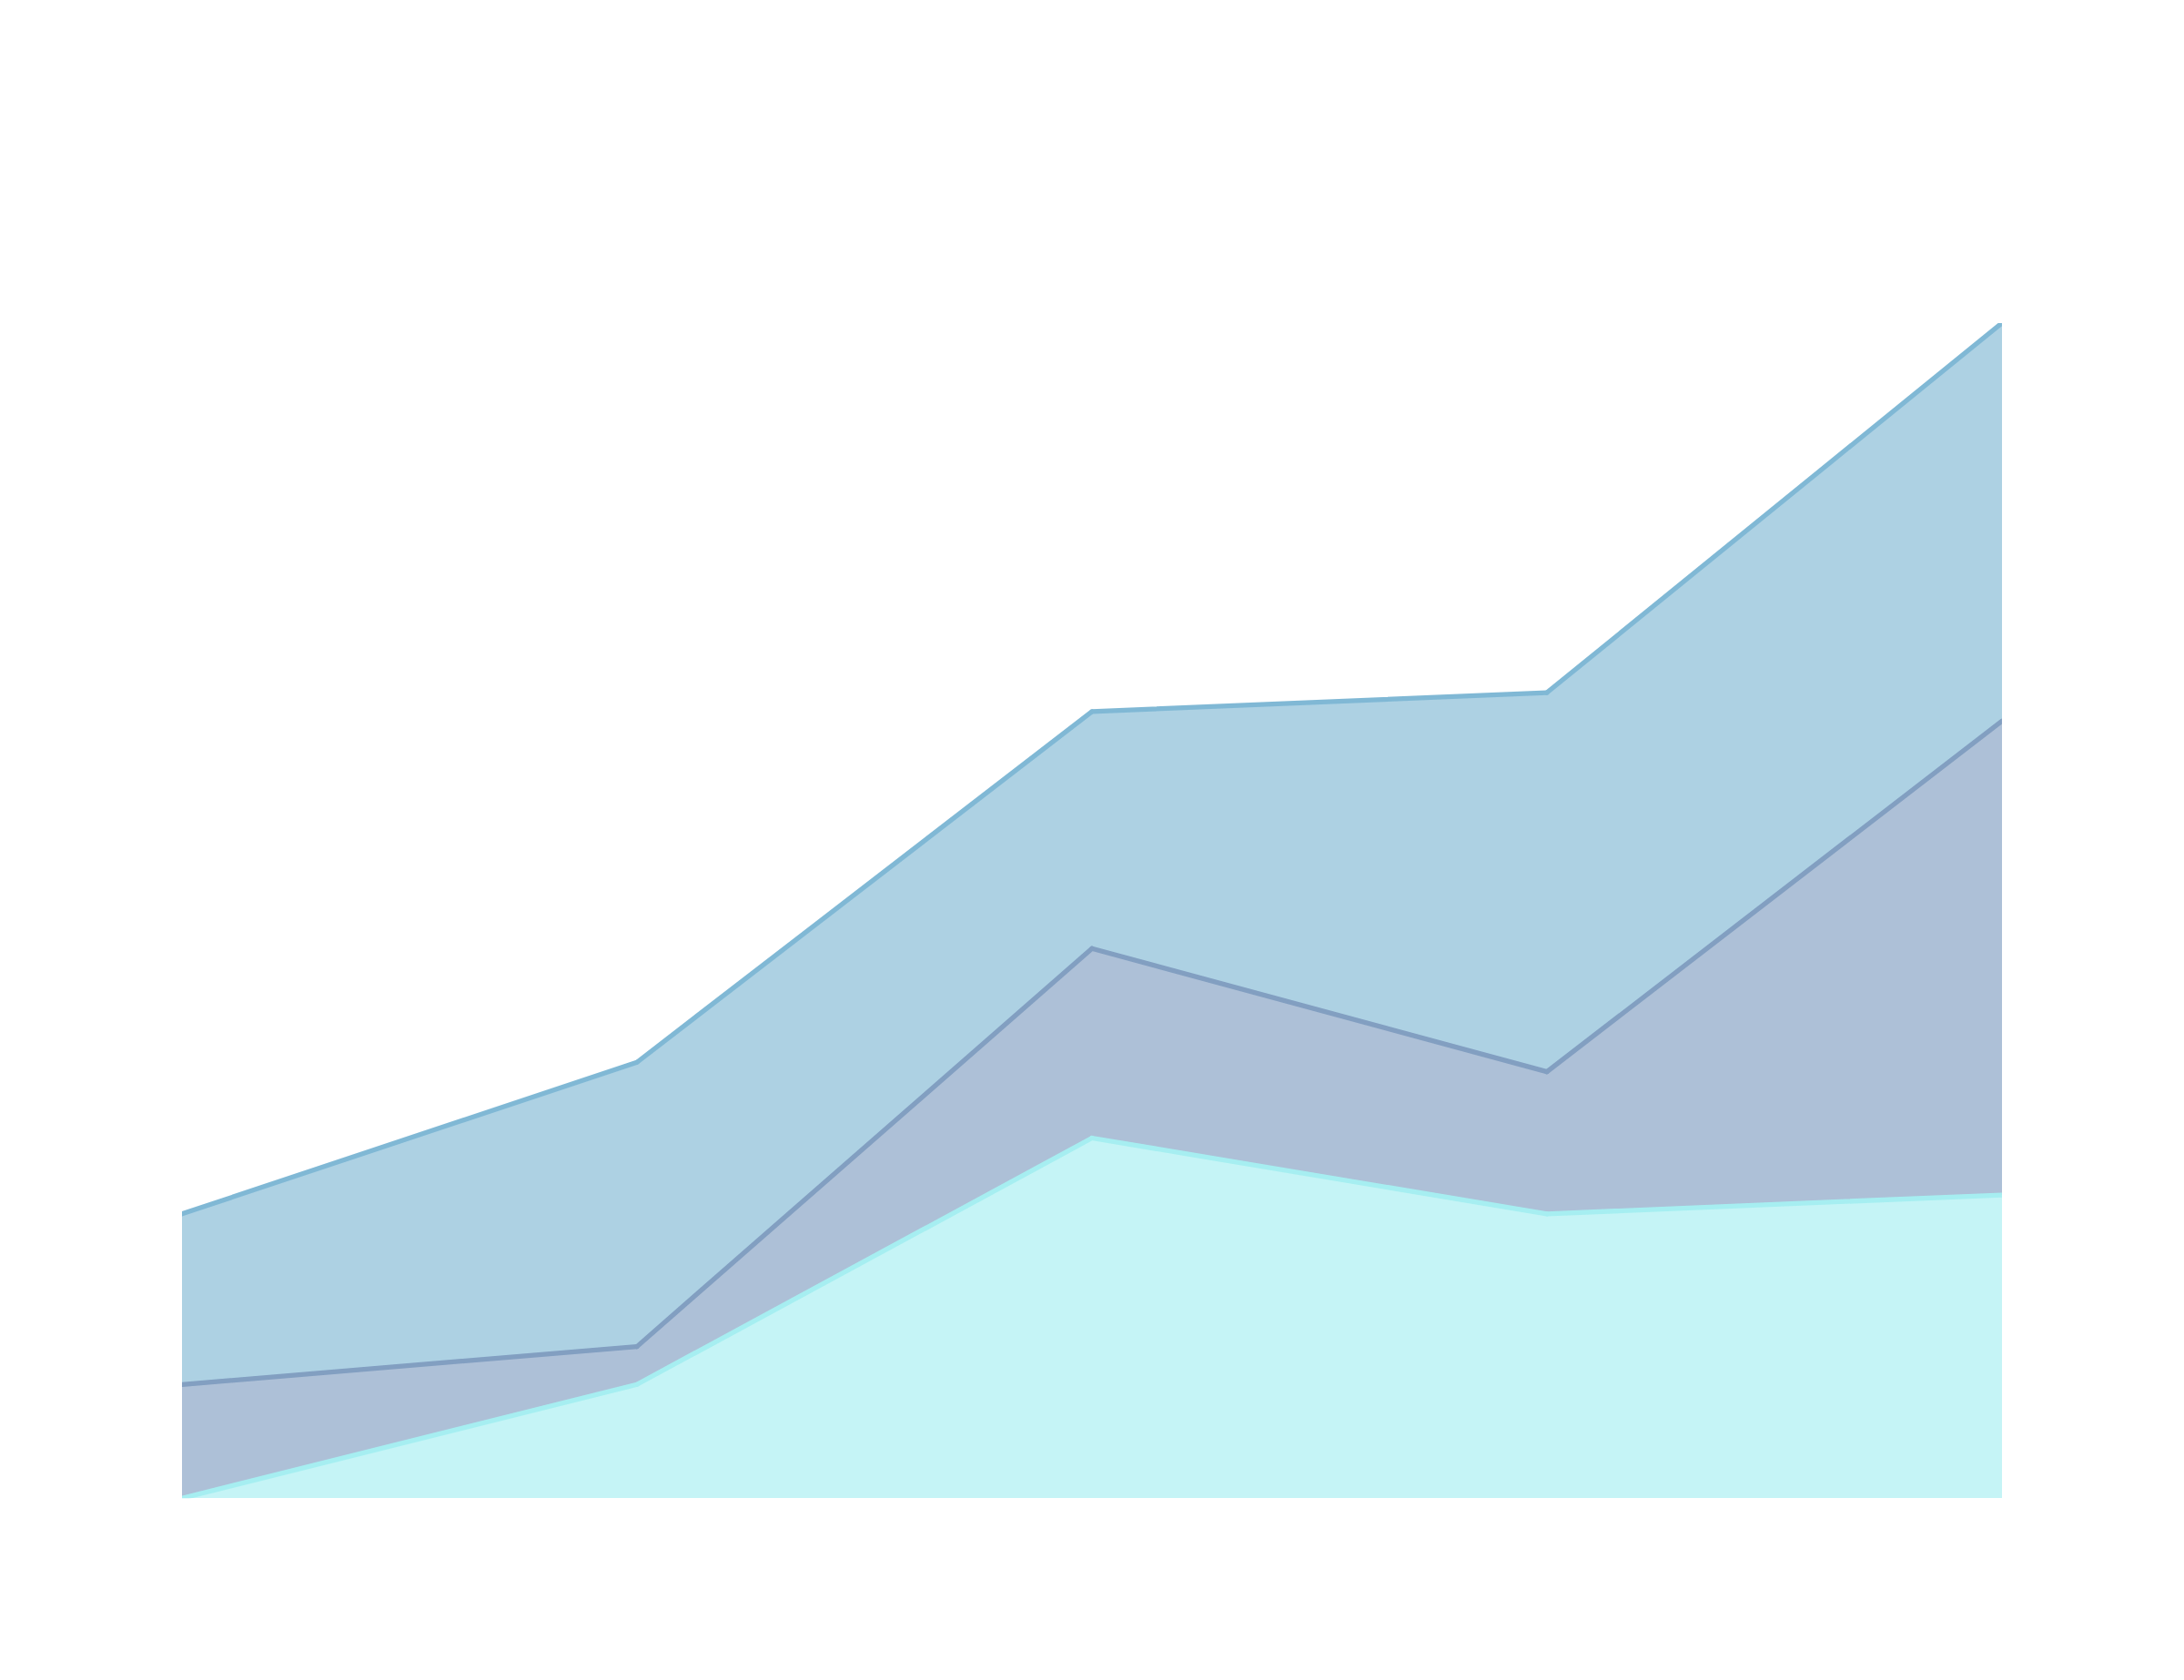

IMPACT OF WORKPLACE STRESS ON
EMPLOYEE MENTAL HEALTH AND WELL-BEING
GROUP 6:
SATWIK KUNAPARAJU
SUSHMITHA MEDURI
PRASANTH SIDDIREDDI
TEJASWI NEELAPU

Slide 2

DOES STRESS REALLY EFFECTS OUR LIVES?
Stress is a natural part of life, but excessive stress can have far-reaching effects on our health, productivity, and overall quality of life
Factors :
1. Productivity
2. Work life
3. Mental Health
4. Physical Health

Slide 3


DATA OVERVIEW:
KEY COLUMNS:
HEALTH & SATISFACTION METRICS
DEMOGRAPHICS
STRESS LEVELS
PHYSICAL ACTIVITY
SLEEP QUALITY
REMOTE WORK SATISFACTION
WORK-LIFE BALANCE RATING
AGE, GENDER, WORK LOCATION
TOTAL RECORDS
WORK METRICS
HOURS WORKED, NUMBER OF VIRTUAL MEETINGS
5000

Slide 4
DATA PREPARATION:
New Features Added
Average Meeting Duration per Week
Physical and Mental Health Index
Productivity Score
Work-Life Balance to Stress Ratio
Work Efficiency score
Cleaned missing values and converted categorical data in numerics to well-defined meaningful names using mutate and case_when in R
ANALYTICAL FOCUS:
Examined correlations between stress levels, work location, productivity, and well-being metrics

Slide 5
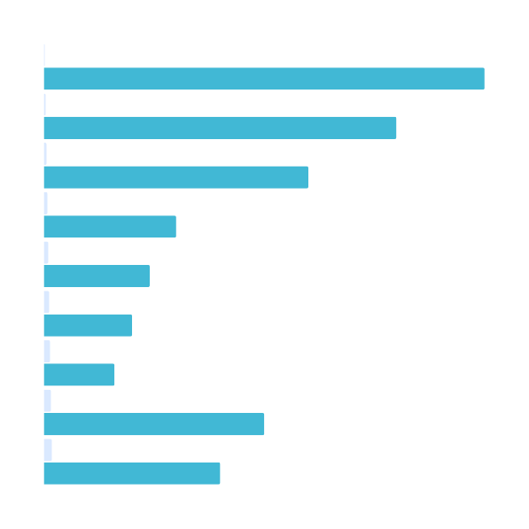
A Visual Representation of Our Findings

Slide 6
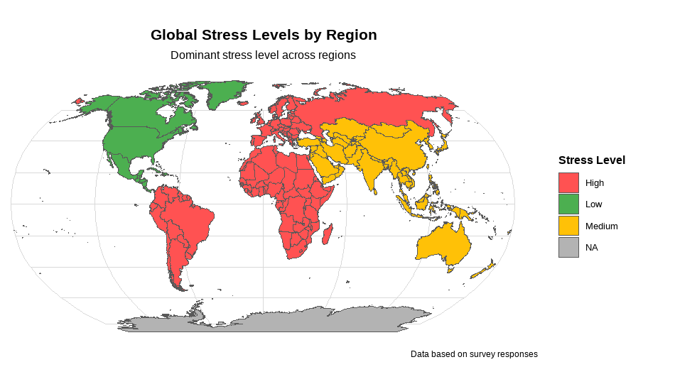

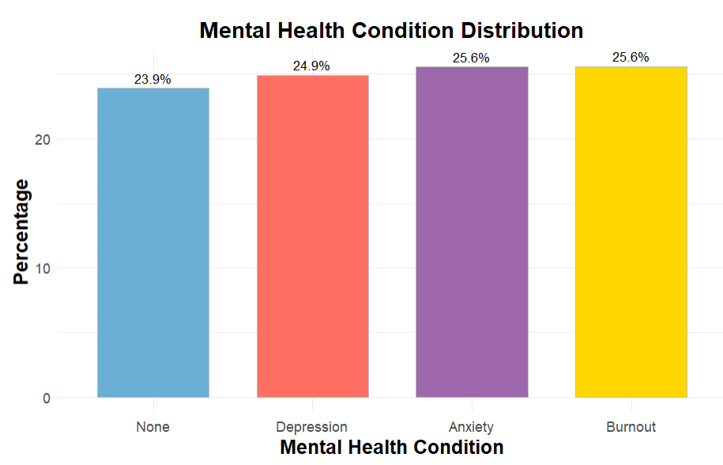
GLOBAL STRESS IMPACT AND
MENTAL HEALTH TRENDS
Stress levels vary significantly across regions, with high stress dominating in many parts of the world. These stress levels directly influence mental health conditions, as seen in the comparable prevalence of anxiety, burnout, and depression globally

Slide 7

STRESS LEVELS ACROSS INDUSTRIES

Slide 8
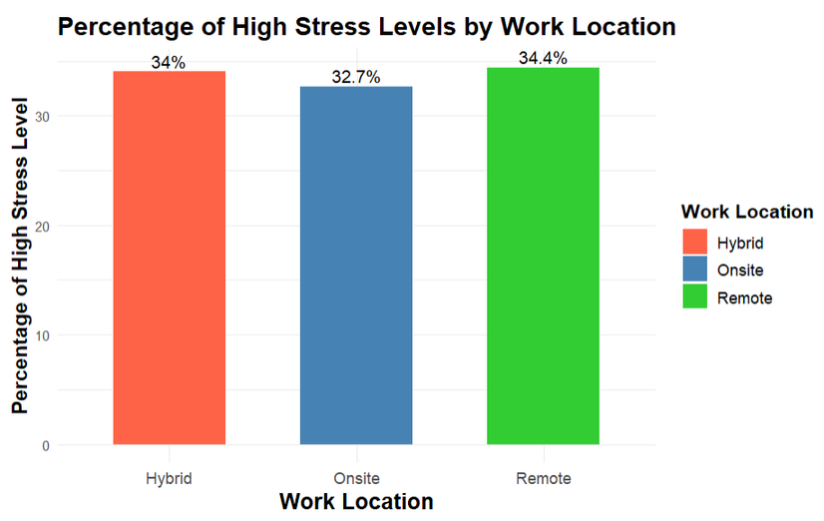
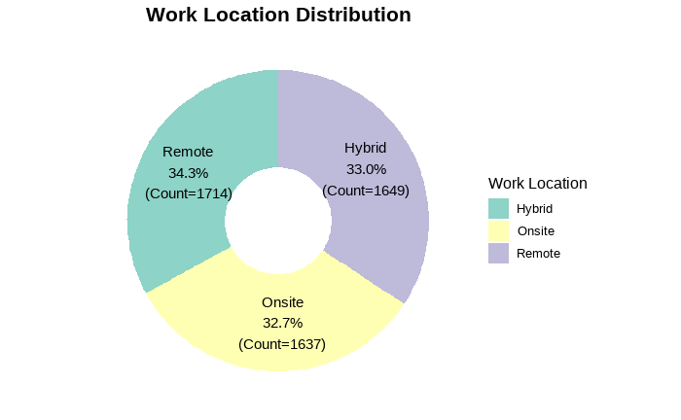

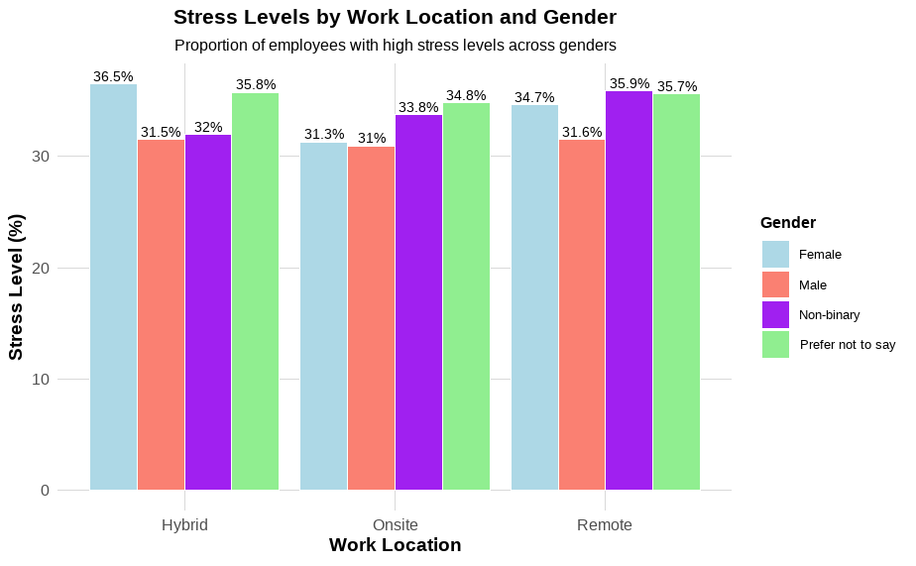
WORK LOCATION AND GENDER INFLUENCE ON STRESS LEVELS
Work location plays a critical role in stress levels, with remote and hybrid workers reporting slightly higher stress than onsite workers. Additionally, gender disparities in high-stress levels are observed across different work arrangements, highlighting the nuanced interplay of work environments and demographics

Slide 9
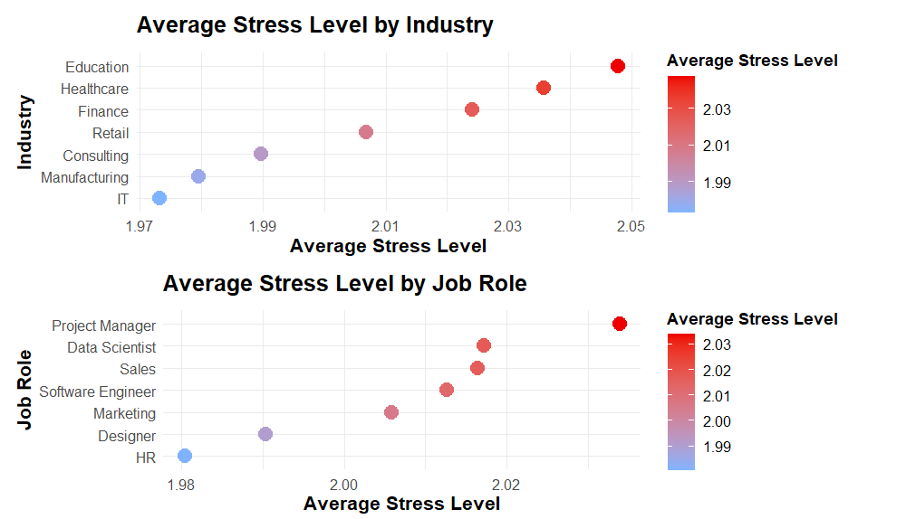

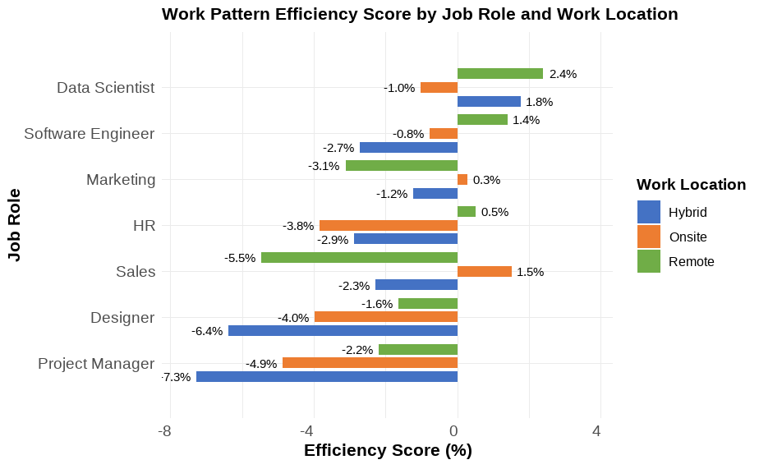
STRESS AND WORK PATTERNS
ACROSS INDUSTRIES AND
JOB ROLES
Stress levels vary significantly across industries and job roles, with Education and Project Management showing higher average stress. Work pattern efficiency also differs based on job roles and work locations, revealing the impact of stress on workplace productivity

Slide 10
THE IMPACT OF STRESS LEVELS ON HEALTH
SLEEP QUALITY
PHYSICAL ACTIVITY
MENTAL HEALTH

Slide 11
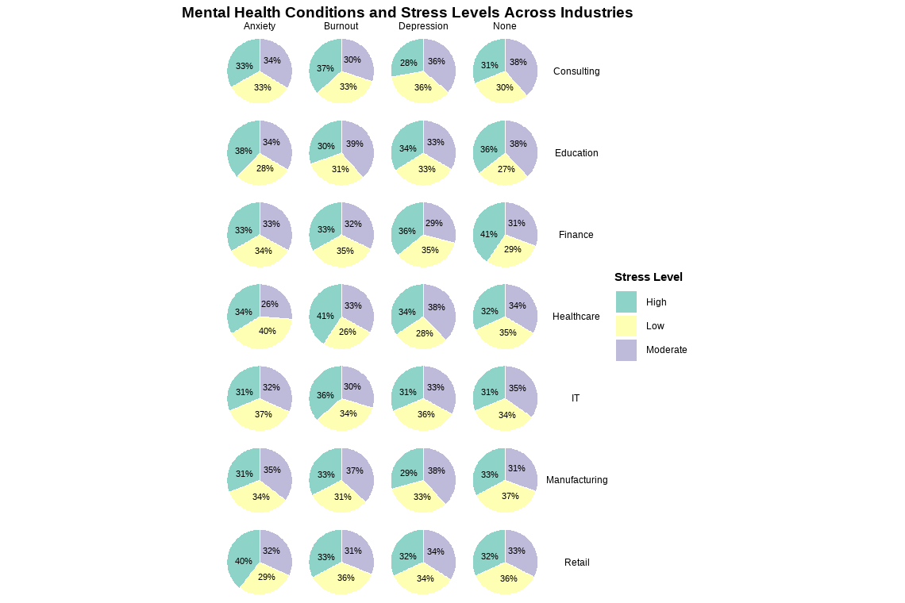

THE IMPACT OF STRESS LEVELS ON MENTAL HEALTH ACROSS INDUSTRIES
Stress levels influence mental health conditions differently across industries. Healthcare and Retail show higher levels of burnout, while Education and Finance exhibit a balance of stress levels impacting conditions like anxiety and depression

Slide 12
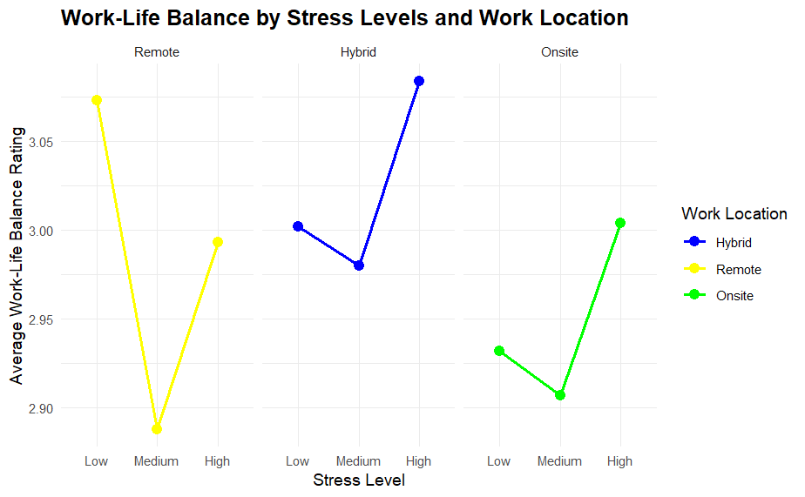

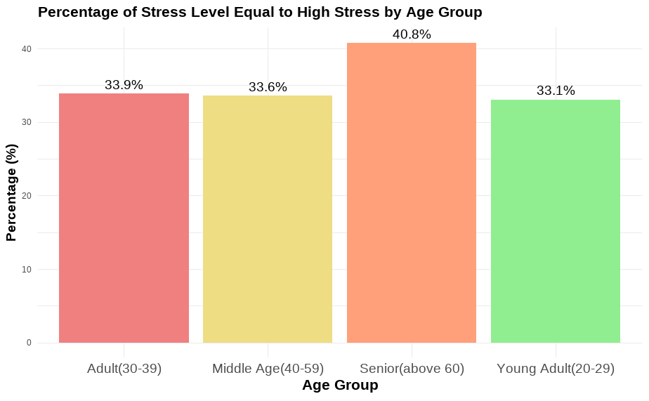
STRESS LEVELS AND WORK-LIFE BALANCE BY AGE AND WORK LOCATION
Senior age groups experience the highest levels of stress, highlighting age as a key factor in stress dynamics. Work-life balance trends vary significantly across stress levels and work locations, with remote workers showing higher resilience under stress

Slide 13
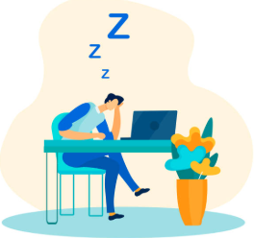
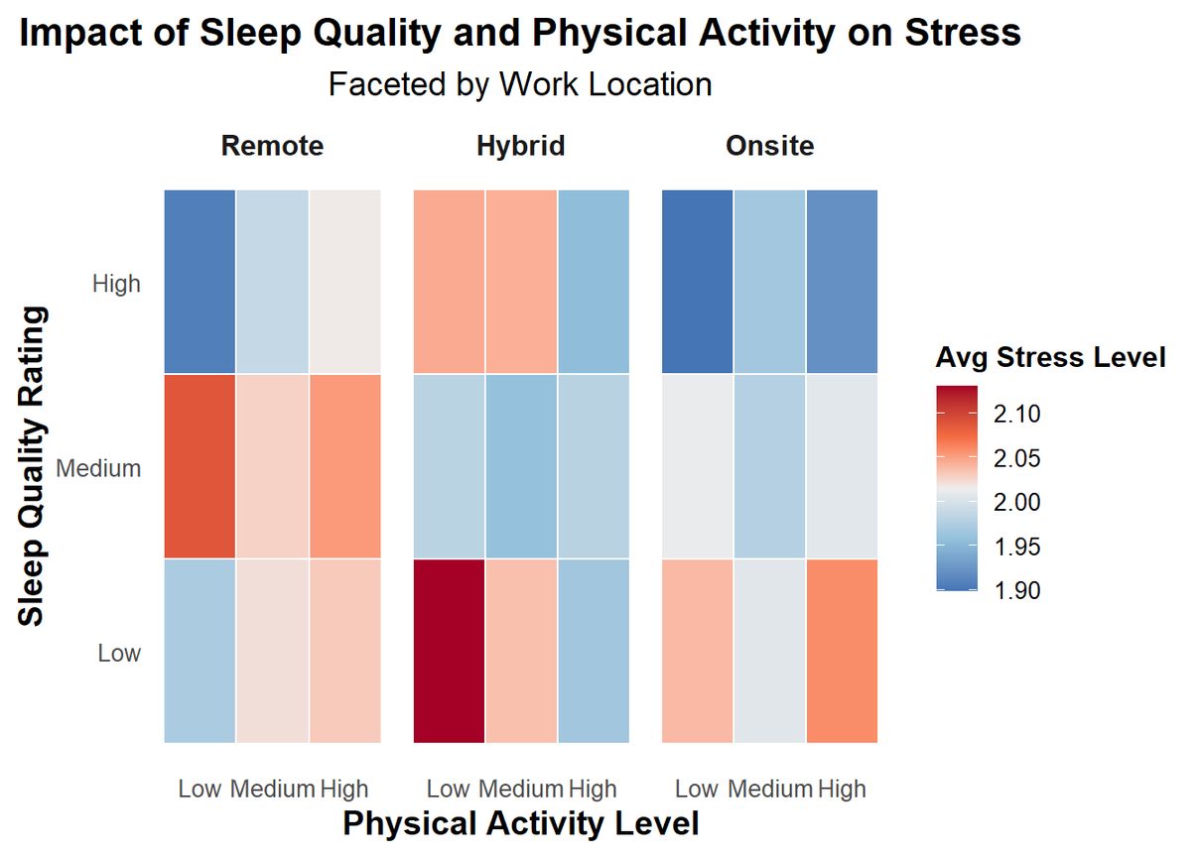
IMPACT OF SLEEP QUALITY AND PHYSICAL ACTIVITY ON STRESS
Stress levels are influenced by a combination of sleep quality and physical activity. Remote workers maintain lower stress with high sleep quality, while hybrid and onsite workers show elevated stress when physical activity is low and sleep quality is moderate.

Slide 14

Conclusion
Conclusion 1
Conclusion 2
Stress levels significantly affect work-life balance, with remote workers coping better than hybrid or onsite workers.
Physical activity and good sleep quality help lower stress levels.
Holistic interventions can improve overall employee well-being and workplace productivity
High stress levels increase the likelihood of burnout, anxiety, and depression.
Healthcare and Retail industries face higher burnout rates compared to other sectors.
Providing targeted mental health support is crucial for improving employee well-being

Slide 15

Thank you for joining us today!
Q & A

